Slide 1
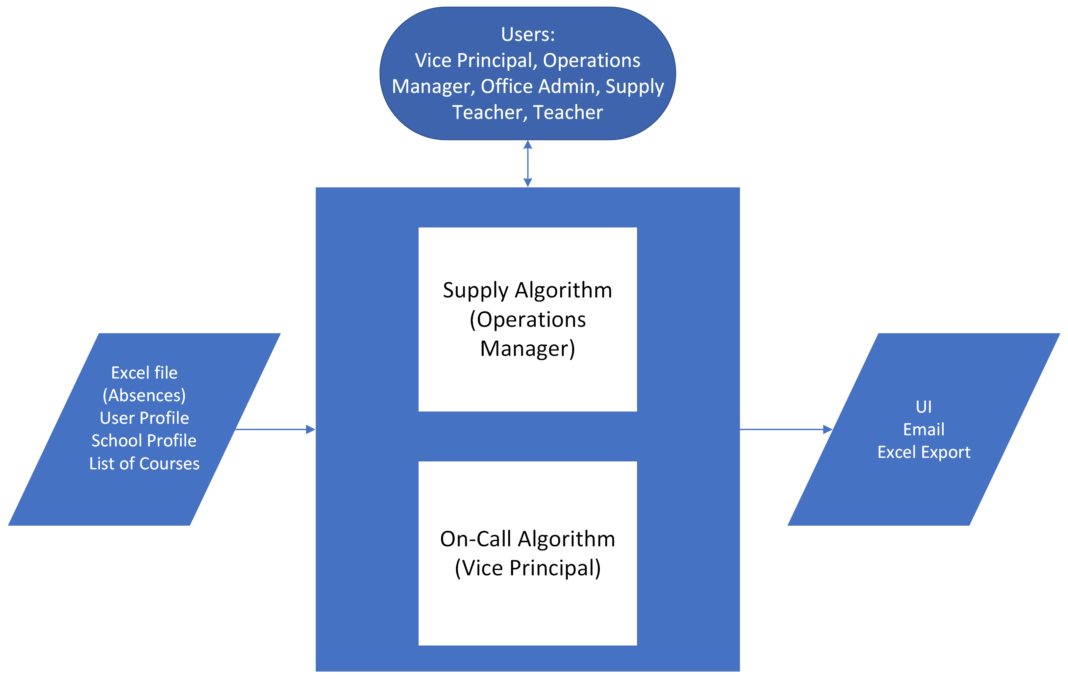
TEAM 2 (IVYSAUR) PROJECT ROADMAP
ON-CALL TRACKING SYSTEM

Slide 2
TEAM 2 (IVYSAUR) PROJECT ROADMAP
ON-CALL TRACKING SYSTEM
First Release
ON-CALL ALGORITHM
SUPPLY DATA
SUPPLY RELEASE
Assign on-call automatically
Show the result on the UI
List of schools
List of supplies
Supply schedule
export the desired spreadsheets
Final release test
Phase 1
Phase 2
Phase 3
Phase 4
Phase 5
Phase 6
ON-CALL DATA
ON-CALL RELEASE
SUPPLY ALGOITHM
List of courses
List of teachers
List of absences
School schedule
export the desired spreadsheets
Add email capabilities
Assign supplies automatically
Show the result on the UI
Final Product

